Slide 1

Medicine
Data Analysis
FINAL PRESENTATION
Mentors : Varun Vennelaganti & Munmun Singh
Presentation by Swaroop

Slide 2
OBJECTIVE
The objective is to create an analysis that can be helpful for providing detailed rating of the of the Medicines and their Conditions.
It could also be helpful for the patients who are buying drugs online to check the effectiveness of the drugs before buying it.

Slide 3
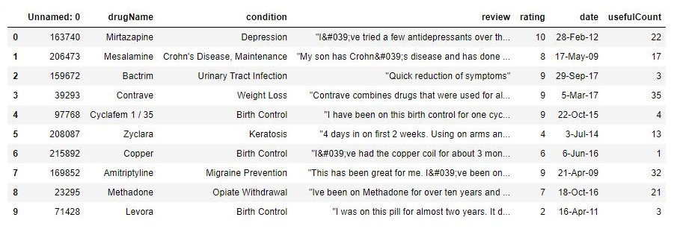
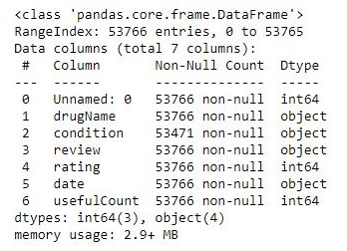
DATASET
The dataset contains patient reviews on specific drugs and with related conditions and their satisfaction rated on a scale of 1 to 10. It also contains the date of review given and Useful Count which indicates the vote given if the users found the review helpful.
The data consists of 53766 entries/rows, and 7 columns with “Unnamed” as another column.

Slide 4
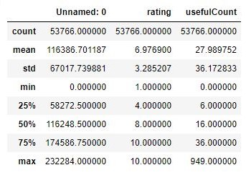
The “Unnamed” / “index”, “rating” & “UsefulCount” are all of the datatype Integer and “DrugName”, “Condition”, “Review” & “Date” are of the datatype Object.
The above image displays the count, mean, standard deviation, min, max values of the Integer data.

Slide 5
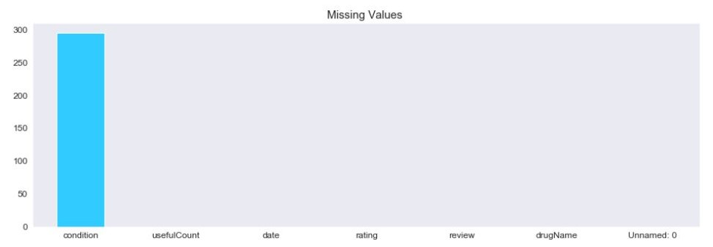
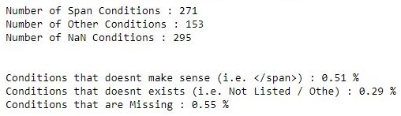

The data also contains missing values. The below image indicates that only the “Condition” feature has about 275 values missing.
On diving a little deeper in this dataset
we also found some interesting information.
We found that there are some condition whose values are “<span>”, which indicates that there has been some error in web scraping the html site for data.
There are also some conditions where the values are not specified and is displayed as “Other” condition.
Thus the total count of conditions that are not correct is 719, which is exactly 1.35% of the total data.

Slide 6

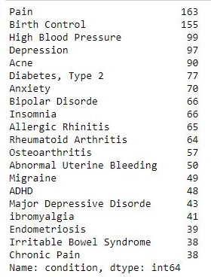
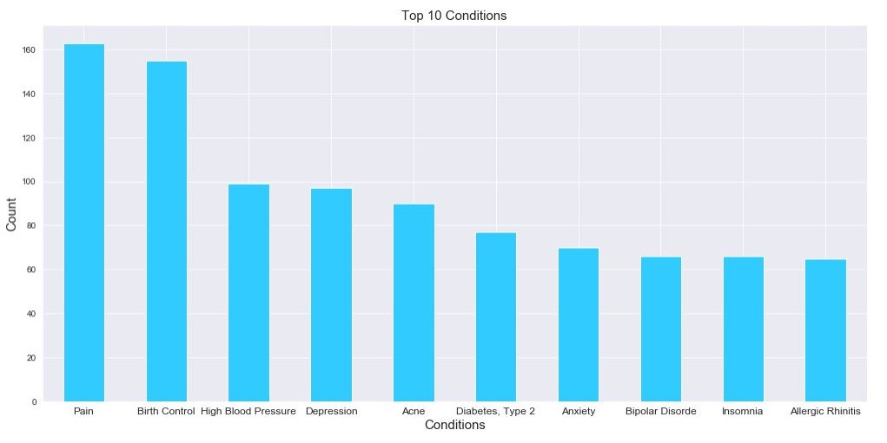
The next was to find how many drug are there exactly and the conditions for them.
There is 2627 unique Drugs and 663 unique conditions.
The top 20 conditions are based on the count of unique drugs.
(i.e. “Pain” has 163 unique Drugs.)

Slide 7
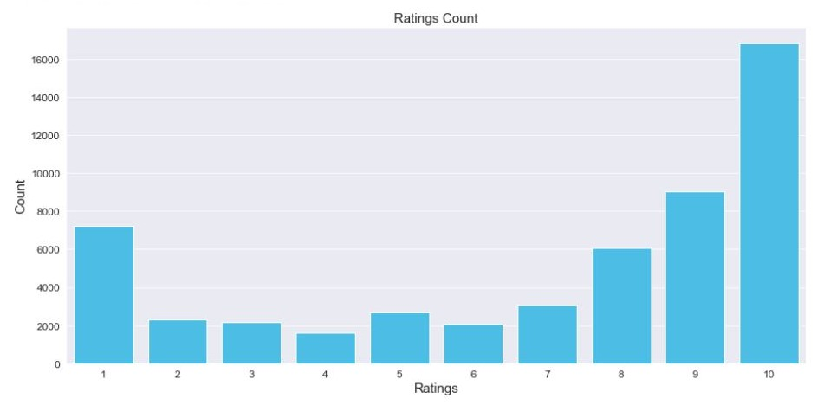
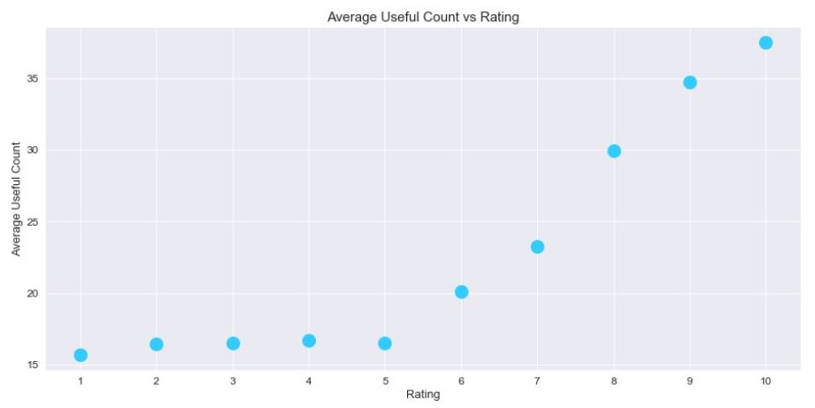
The rating as explained before contains values from 1 to 10. The finding are as follows,
The rating “10” has more values than all other ratings, rating “9” contains the next most values.
But the thing is that we don’t know under what situations the reviews are given. Thus the ratings are to be averaged.
The above image shows the averaged UsefulCount vs Rating. There is a drastic increase after the rating “5” till rating “10”.
It shows that the usefulness of the review increases with the increase in the rating.

Slide 8
The main objective of this project is to provide Sentiment Analysis on reviews tab.
To that first we have to preprocess the all the review. This involves the following steps
Convert the HTML information to normal readable text.
Convert all the upper case text to lower case to avoid the misinformation.
Next we have to remove all the stops words, but the thing is some of the stops words
that are included in NLTK package are useful for the analysis in this domain.
Thus we create another list containing such words and removing them from the main stop words list.
Also we have to remove single characters from the reviews.
We have to remove all other characters that are not alphabets.
After doing all the above steps, we combine all the words to make the review whole

Slide 9
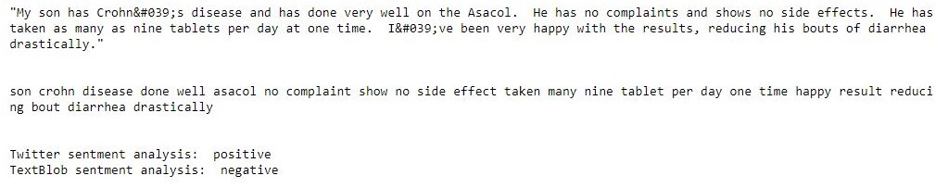
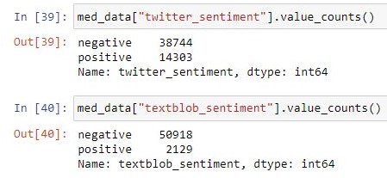
We can also use a “TextBlob”, an inbuilt package that is a lighter version of NLTK package from python.
But the results are not good, because TextBlob converts the text into words by dividing them and the assigns predetermined scores/values/weights to each words based on the sentiment of the word. But in our project domain, this predetermined values causes a lot of confusion and results are not always correct.
Thus to avoid this disadvantage, I created my own dataset of messages/sentences that are derived from Twitter with positive and negative labels assigned to them. This can be found in the NLTK package. This text data is then run through Naïve Bayes Classifier to determine the results and create model which can then be used to classify our data (i.e. the reviews). The results are much better compared to TextBlob results.
Consider the below sample, on observing the text we get to know that the sentiment it portrays is positive. But the textblob analysis displays its result as negative. Thus we know that textblob analysis for this data is not accurate.
We also get to know the exact total count of sentiments for the data.

Slide 10
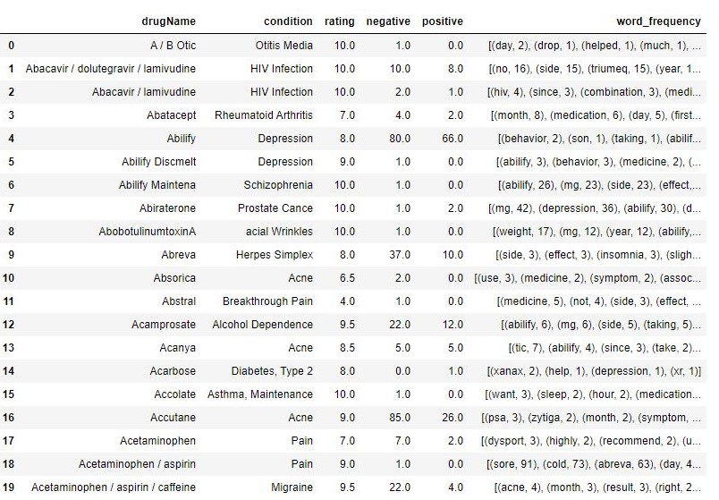
RESULTS
We have done our analysis, we have also predicted our sentiments out of the reviews.
The only thing we have left to do is calculate the ratings, positive sentiment, negative sentiment and word frequency for each unique drug. This is done be combining all the data for each drug.

Slide 11
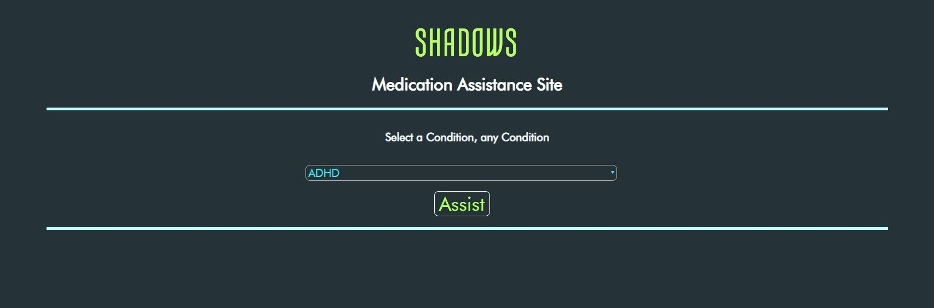
DEPLOYMENT

Slide 12
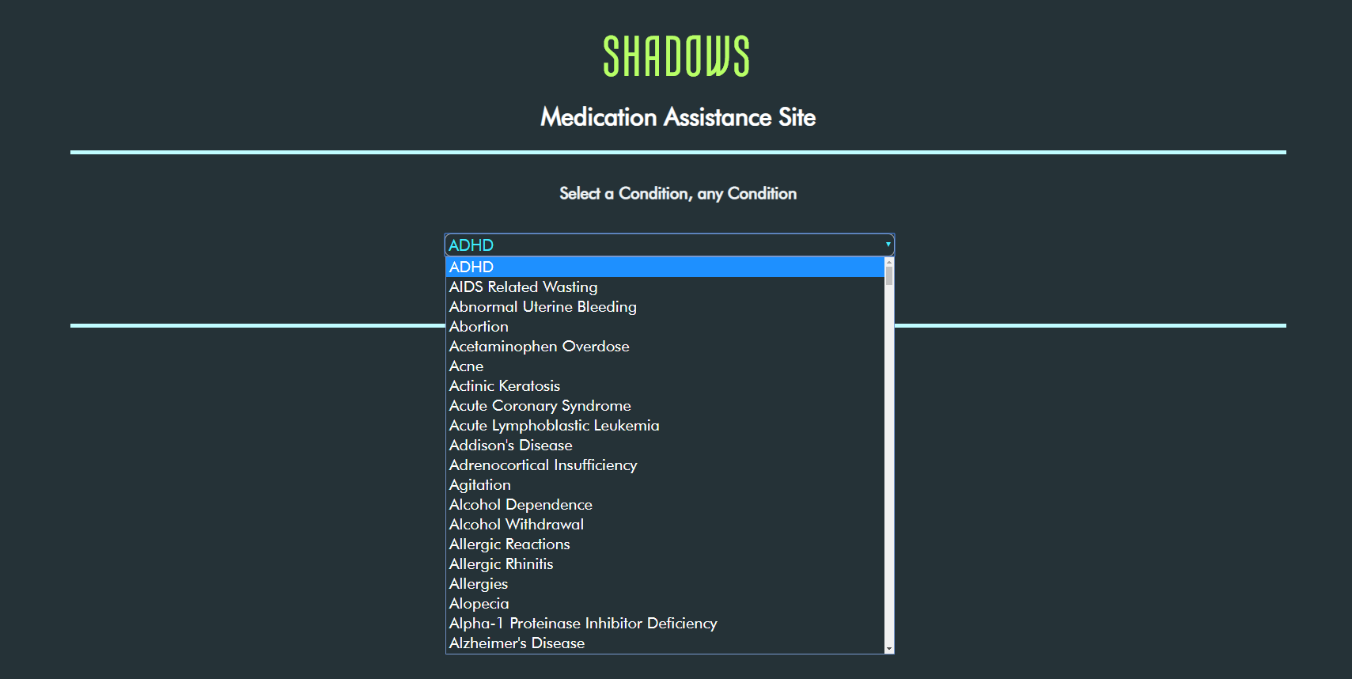

Slide 13
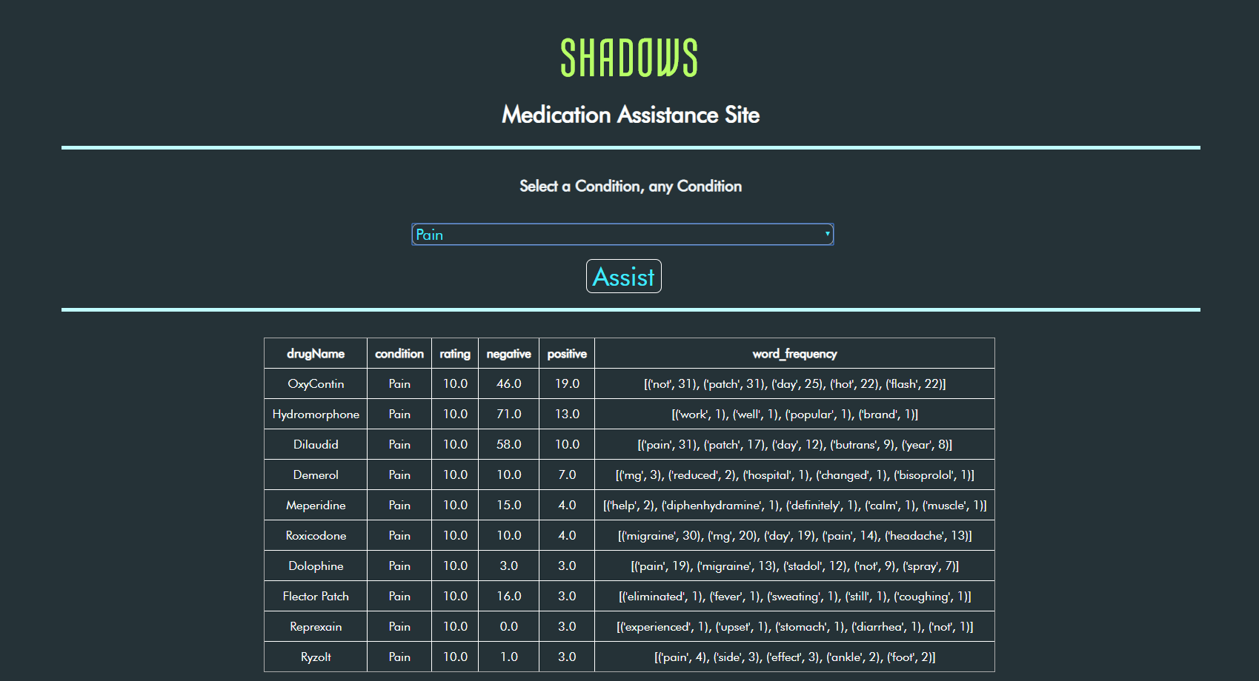

Slide 14
CHALLENGES FACED
The conditions column “NA” values, “</span>” values and “other” values.
The review text is not extracted correctly from the HTML site, cause it contains tags like “</span>” and HTML codes for special characters and symbols.
The review column also contains reviews that have no direct relation to the Drug.
The rating given is also a major obstacle as we don’t know whether the rating are for the drugs or for its corresponding review.
The above issue is same for UsefulCount also. We also don’t know whether the people who found the review useful or the drug.
For results textblob gave different results than twitter analysis. There maybe more model that might provide a better understanding of the data.
On the final note, for the end result table, the ratings for each are to be combined to give a more general result. But which method to combine them is the issue, because mean would not give better result when there are less number of ratings and mode would just give rating which has maximum count.

Slide 15
THANK YOU

